Slide 1
Engineering Economy
Chapter 9: Replacement Analysis

Slide 2
The objective of Chapter 9 is to address the question of whether a currently owned asset should be kept in service or immediately replaced.

Slide 3
What to do with an existing asset?
Keep it
Abandon it (do not replace)
Replace it, but keep it for backup purposes
Augment the capacity of the asset
Dispose of it, and replace it with another

Slide 4
Three reasons to consider a change.
Physical impairment (deterioration)
Altered requirements
New and improved technology is now available.
The second and third reasons are sometimes referred to as different categories of obsolescence.

Slide 5
Some important terms for replacement analysis
Economic life: the period of time (years) that yields the minimum equivalent uniform annual cost (EUAC) of owning and operating as asset.
Ownership life: the period between acquisition and disposal by a specific owner.
Physical life: period between original acquisition and final disposal over the entire life of an asset.
Useful life: the time period an asset is kept in productive service (primary or backup).

Slide 6
Replacement: past estimation errors
Any study today is about the future—past estimation “errors” related to the defender are irrelevant.
The only exception to the above is if there are income tax implications forthcoming that were not foreseen.

Slide 7
Replacement: watch out for the sunk-cost trap
Only present and future cash flows are considered in replacement studies.
Past decisions are relevant only to the extent that they resulted in the current situation.
Sunk costs—used here as the difference between an asset’s BV and MV at a particular point in time—have no relevance except to the extent they affect income taxes.

Slide 8
Replacement: the outsider viewpoint
The outsider viewpoint is the perspective taken by an impartial third party to establish the fair MV of the defender. Also called the opportunity cost approach.
The opportunity cost is the opportunity foregone by deciding to keep an asset.
If an upgrade of the defender is required to have a competitive service level with the challenger, this should be added to the present realizable MV.

Slide 9
Replacement: economic lives of the challenger and defender
The economic life of the challenger minimizes the EUAC.
The economic life of the defender is often one year, so a proper analysis may be between different-lived alternatives.
The defender may be kept longer than it’s apparent economic life as long as it’s marginal cost is less than the minimum EUAC of the challenger over it’s economic life.

Slide 10
Replacement: income taxes
Replacement often results in gains or losses from the sale of depreciable property.
Studies must be made on an after-tax basis for an accurate economic analysis since this can have a considerable effect on the resulting decision.

Slide 11
Before-tax PW example
Acme owns a CNC machine that it is considering replacing. Its current market value is $25,000, but it can be productively used for four more years at which time its market value will be zero. Operating and maintenance expenses are $50,000 per year
Acme can purchase a new CNC machine, with the same functionality as the current machine, for $90,000. In four years the market value of the new machine is estimated to be $45,000. Annual operating and maintenance costs will be $35,000 per year.
Should the old CNC machine be replaced using a before-tax MARR of 15% and a study period of four years?

Slide 12


Example solution
Defender
Challenger
PW of the challenger is greater than PW of the defender (but it is close).

Slide 13
Proper analysis requires knowing the economic life (minimum EUAC) of the alternatives.
The EUAC of a new asset can be computed if the capital investment, annual expenses, and year-by-year market values are known or can be estimated.
The difficulties in estimating these values are encountered in most engineering economy studies, and can be overcome in most cases.

Slide 14

Finding the EUAC of the challenger requires finding the total marginal cost of the challenger, for each year. The minimum such value identifies the economic life.
This equation represents the present worth, through year k, of total costs. (Although the sign is positive, it is a cost. Eq. 9-1.)

Slide 15
Total marginal cost formula
The total marginal cost is the equivalent worth, at the end of year k, of the increase in PW of total cost from year k-1 to year k.
This can be simplified to (eq. 9-2)

Slide 16
Finding the economic life of the new CNC machine.
 | Year 1 | Year 2 | Year 3 | Year 4
O&M costs | $35,000 | $35,000 | $35,000 | $35,000
Market value | $75,000 | $60,000 | $50,000 | $45,000
Marginal costs:
 | Year 1 | Year 2 | Year 3 | Year 4
O&M | $35,000 | $35,000 | $35,000 | $35,000
Depreciation | $15,000 | $15,000 | $10,000 | $5,000
Int. on capital | $13,500 | $11,250 | $9,000 | $7,500
TC | $63,500 | $61,250 | $54,000 | $47,500

Slide 17
Pause and solve
In a replacement analysis for an industrial saw, the following data are known about the challenger. Initial investment is $18,000. Annual maintenance costs begin at the end of year three, with a cost at that time of $1,000, with $1,000 at the end of year four, increasing by $8,600 each year thereafter. The salvage value is $0 at all times. Using a MARR of 6% per year, what is the economic life of the challenger?

Slide 18
Solution
From the economic life table below, we see the EUAC reaches a minimum in year 4, which is the economic life of this challenger.
EOY | MV@ EOY | Loss in MV | Cost of Capital | Annual Expense | TC for year | EUAC
0 | 18,000
1 | 0 | 18,000 | 1,080 | 0 | 19,080 | 19,080
2 | 0 | 0 | 0 | 0 | 0 | 9,818
3 | 0 | 0 | 0 | 1,000 | 1,000 | 7,048
4 | 0 | 0 | 0 | 1,000 | 1,000 | 5,666
5 | 0 | 0 | 0 | 9,600 | 9,600 | 6,364
6 | 0 | 0 | 0 | 18,200 | 18,200 | 8,060

Slide 19
The economic life of the defender
If a major overhaul is needed, the life yielding the minimum EUAC is likely the time to the next major overhaul.
If the MV is zero (and will be so later), and operating expenses are expected to increase, the economic life will the one year.
The defender should be kept as long as its marginal cost is less than the minimum EUAC of the best challenger.

Slide 20
Finding the economic life of the defender CNC machine.
 | Year 1 | Year 2 | Year 3 | Year 4
O&M costs | $50,000 | $50,000 | $50,000 | $50,000
Market value | $15,000 | $10,000 | $5,000 | $0
 | Year 1 | Year 2 | Year 3 | Year 4
O&M | $50,000 | $50,000 | $50,000 | $50,000
Depreciation | $10,000 | $5,000 | $5,000 | $5,000
Int. on capital | $3,750 | $2,250 | $1,500 | $750
TC | $63,750 | $57,250 | $56,500 | $55,750

Slide 21
Replacement cautions.
In general, if a defender is kept beyond where the TC exceeds the minimum EUAC for the challenger, the replacement becomes more urgent.
Rapidly changing technology, bringing about significant improvement in performance, can lead to postponing replacement decisions.
When the defender and challenger have different useful lives, often the analysis is really to determine if now is the time to replace the defender.
Repeatability or cotermination can be used where appropriate.

Slide 22
Abandonment is retirement without replacement.
For projects having positive net cash flows (following an initial investment) and a finite period of required service.
Should the project be undertaken? If so, and given market (abandonment) values for each year, what is the best year to abandon the project? What is its economic life?
These are similar to determining the economic life of an asset, but where benefits instead of costs dominate.
Abandon the year PW is a maximum.

Slide 23
Abandonment example
A machine lathe has a current market value of $60,000 and can be kept in service for 4 more years. With an MARR of 12%/year, when should it be abandoned? The following data are projected for future years.
 | Year 1 | Year 2 | Year 3 | Year 4
Net receipts | $50,000 | $40,000 | $15,000 | $10,000
Market value | $35,000 | $20,000 | $15,000 | $5,000

Slide 24


Abandonment solution
Keep for one year
Keep for two years
Keep for three years (BEST!)
Keep for four years

Slide 25
Taxes can affect replacement decisions.
Most replacement analyses should consider taxes.
Taxes must be considered not only for each year of operation of an asset, but also in relation to the sale of an asset.
Since depreciation amounts generally change each year, spreadsheets are an especially important tool to use.

Slide 26
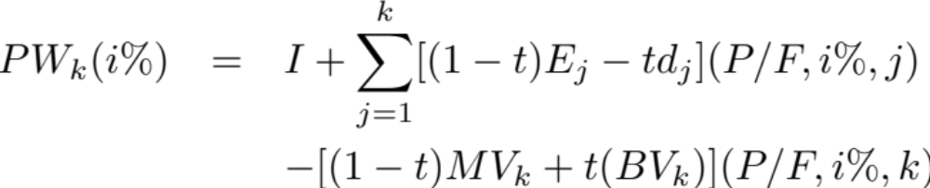
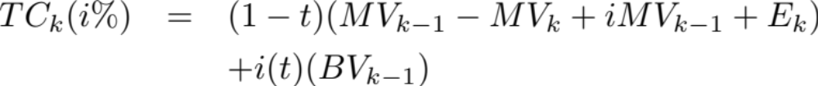
The effect of taxes.
The economic life of an asset becomes, after taxes, (eq. 9-3)
which reflects not only annual taxes but also tax effects of the sale of the asset. The total marginal cost, for each year, is (eq. 9-4)

Slide 27
We must also consider the possible tax effects of the sale of the defender.
The MV of the asset must be compared to the BV to assess the possible tax implications, and this should be reflected in the opportunity cost of keeping the defender. The net ATCF, if the defender is kept, after taxes, is

Slide 28
Pause and solve
Acme Cycles purchased a bending machine two years ago for $45,000. Depreciation deductions have followed the MACRS (GDS, 3-year recovery period) method. Acme can sell the bending machine now for $12,000. Assuming an effective income tax rate of 45% compute the after-tax investment value of the bending machine if it is kept.

Slide 29
Solution
First, find the current book value.
BV = $45,000 (1 – 0.3333 – 0.4445) = $10,000
Next, find the ATCF if the machine is kept.
BTCF | Depreciation | Taxable income | Cash flow for tax | ATCF
-$12,000 | $0 | -($12,000-$10,000)=$2,000 | -0.45*$2,000 = -$900 | -$12,900

